Slide 1

Databases
Denis McCarthy
Denis.mccarthy@tus.ie
RoomU302

Slide 2
Chapter 2
Data Systems

Slide 3
What is a Database?
An organised collection of data
The data refers to several applications
The data does not contain any unnecessary duplication

Slide 4
Why do we need DBMS?
Traditional Data processing
Each application has its own files

Slide 5
Why do we need DBMS?
Staff File
Payroll
System
Reports
Class Data
File
Class Scheduling
System
Reports
Student Data
File
Result Posting
System
Reports
* Each file exists independently but what if
- need access to several files and
- several applications need access to the same data.

Slide 6
Why do we need DBMS? Alternative
DBMS
Datadef
Payroll
System
Reports
Faculty
Data
DBMS
Class
Scheduling
Reports
Class
Data
Student
Data
Result
Posting
Reports

Slide 7
Why the alternative?
Payroll system etc performs its old functions but calls on DBMS to access the database.
All files are created by DBMS
therefore all of the data is compatible and
DBMS ensures integrity.
Remember that a Database is an organised collection of DATA

Slide 8
Data vs. Information
Data:
Raw facts; building blocks of information
Unprocessed information
Information:
Data processed to reveal meaning
Accurate, relevant, and timely information is key to good decision making
Good decision making is key to survival in global environment

Slide 9
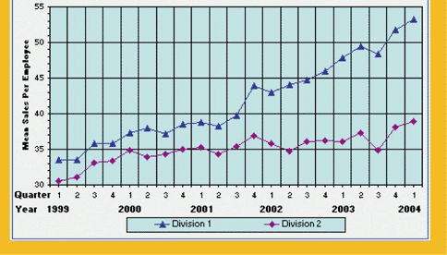
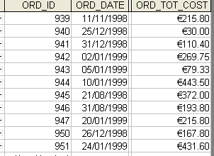
Data versus Information
Data
Information
Fig 2.1 Data Versus Information

Slide 10
Introducing the Database and the DBMS
Database—shared, integrated computer structure that houses:
End user data (raw facts)
Metadata (data about data)
DBMS (database management system):
Collection of programs that manages database structure and controls access to data
Possible to share data among multiple applications or users
Makes data management more efficient and effective
End users have better access to more and better-managed data
Promotes integrated view of organization’s operations
Probability of data inconsistency is greatly reduced
Possible to produce quick answers to ad hoc queries

Slide 11
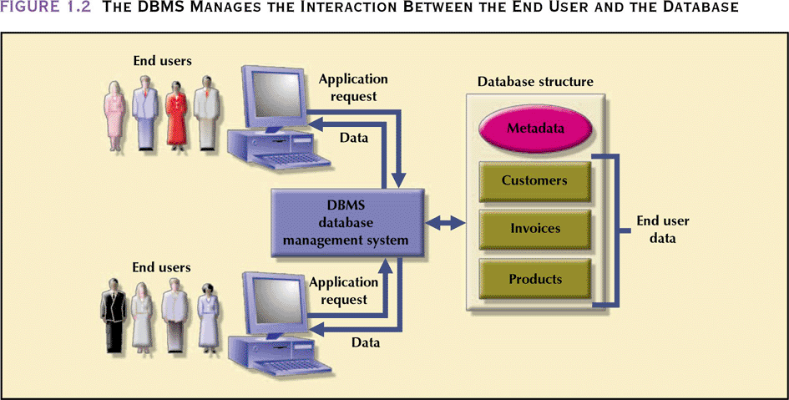
End User ↔ DBMS ↔ Database
The DBMS Manages the Interaction between the End User and the Database

Slide 12
Types of Databases
Single-user:
Supports only one user at a time
Desktop:
Single-user database running on a personal computer
Multi-user:
Supports multiple users at the same time
Workgroup:
Multi-user database that supports a small group of users or a single department
Enterprise:
Multi-user database that supports a large group of users or an entire organization

Slide 13
Location of Databases
Centralized:
Supports data located at a single site
Distributed:
Supports data distributed across several sites

Slide 14
Uses of Databases
Transactional (or production):
Supports a company’s day-to-day operations
Data warehouse:
Stores data used to generate information required to make tactical or strategic decisions
Such decisions typically require “data massaging”
Often used to store historical data
Structure is quite different

Slide 15
Why Database Design is Important
Defines the database’s expected use
Different approach needed for different types of databases
Avoid redundant data (unnecessarily duplicated)
Poorly designed database generates errors → leads to bad decisions → can lead to failure of organization

Slide 16
The Database System Environment
Database system is composed of 5 main parts:
Hardware
Software
Operating system software
DBMS software
Application programs and utility software
People
Procedures
Data

Slide 17
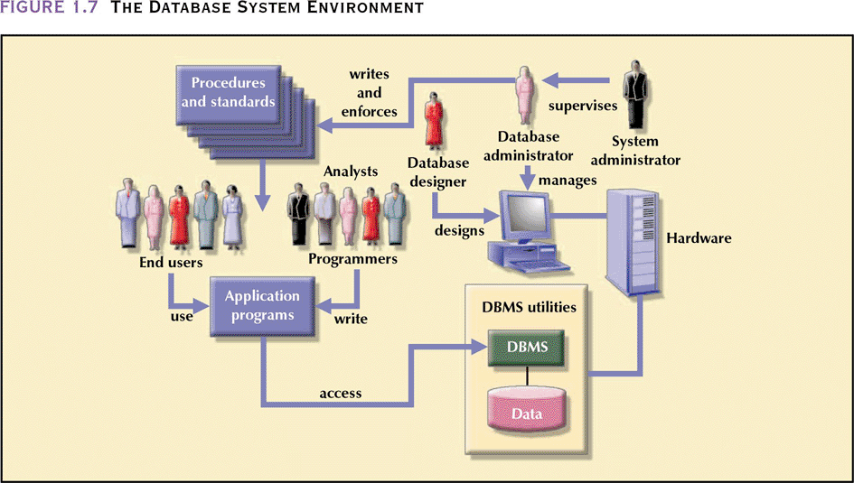
The Database System Environment
Fig 2.3 The Database System Environment

Slide 18
DBMS Functions
Performs functions that guarantee integrity and consistency of data
Data dictionary management
defines data elements and their relationships
Data storage management
stores data and related data entry forms, report definitions, etc.
Data transformation and presentation
translates logical requests into commands to physically locate and retrieve the requested data
Security management
enforces user security and data privacy within database
Multi-user access control
creates structures that allow multiple users to access the data

Slide 19
DBMS Functions (continued)
Backup and recovery management
provides backup and data recovery procedures
Data integrity management
promotes and enforces integrity rules to eliminate data integrity problems
Database access languages and application programming interfaces
provides data access through a query language
Database communication interfaces
allows database to accept end-user requests within a computer network environment

Slide 20
Advantages of DB processing
More information can be produced for a given amount of data i.e. combining facts
separated we can find average salary of all faculty but not average salary of all faculty teaching Maths.
Reduce Data Duplication - space and integrity advantages
Creation of program/data independence.
If data shared by 20 users for example can afford to have specialists responsible for maintaining data. Leads to a better database for all users.

Slide 21
Disadvantages of DB processing
Expensive (DBMS = additional S/W)
memory
operational costs
hardware
Complex. Structures and Inter-relationships difficult.
Need sophisticated systems to handle/use data.
Security & Accuracy (Integrity) problems.

